Slide 1
Is it any good? Accuracy claims and the cost of mistakes
How do I judge a vendor who says “95% accurate”, and what will its mistakes cost us?
Leading with AI | Session 3 of the 15 (Sessions 0 to 14)
KLAi Professional Learning | Jotham Martin Wambi
Notes:
Welcome back. In Session 2 a model learned from past records, gave each new case a score, and someone in your organisation set the cut-off. Today we ask whether such a system is any good. Every vendor will tell you a number, often ninety-five per cent accurate, so our question is this: how do I judge a vendor who says 95% accurate, and what will its mistakes cost us?
We start with Kenya’s health insurer, build the idea with pictures of people and counts, tour six industries, and price the mistakes of a recorded model in shillings.

Slide 2



What you will leave with today
By the end of today you will have
Name the two ways a system can be wrong, false alarms and misses, and say why 95% accurate can be useless when the event is rare
Treat the cut-off as a business dial, and choose its setting by pricing each kind of mistake in shillings
Ask a vendor the questions that test an accuracy claim, and add the cost of a mistake to each portfolio entry
Notes:
Today you learn to name the two ways a system can be wrong, and say why ninety-five per cent can be useless when the thing you look for is rare. You will treat the cut-off as a business dial and set it by pricing each mistake in shillings.
And you will hold the questions that test a vendor’s claim, with a cost-of-a-mistake line on each entry in your portfolio.

Slide 3

Your two hours: the idea, the industries,
a demonstration, then your own portfolio
I run a recorded demonstration. You price the mistakes in your own portfolio.
Notes:
Ten minutes to recall Session 2 and meet today’s question. Forty minutes on false alarms, misses and the cut-off, then the tour of six industries and three real cases. Fifteen minutes of demonstration on recorded runs, where we turn the dial and price the mistakes. A five-minute break.
Ten minutes on your people and the questions to ask. Then twenty-five minutes on your own portfolio, five on your decision, and ten to close.

Slide 4
Three questions from last time
1. In Session 2, what does a model need to learn a prediction?
2. A model scores 192 of 192 on the records it learned from. What do you ask?
3. Who sets the cut-off on a score?
Answer aloud first. Then we check together.
Notes:
Three quick questions from Session 2. Answer aloud first, and then we check together.
Question one. In Session 2, what does a model need to learn a prediction? Take a moment.
A good answer is this. Past records in which the outcome is known, such as repaid or not repaid.
Question two. A model scores 192 of 192 on the records it learned from. What do you ask? Say it to yourself first.
A good answer is this. The score on records it never saw. The unlimited tree got 42 of 48 of those.
Question three. Who sets the cut-off on a score? Think about your own work as you answer.
A good answer is this. Your policy, through a named person or committee. The model only gives the score.
If an answer was missing, last session’s take-away sheet has it.

Slide 5
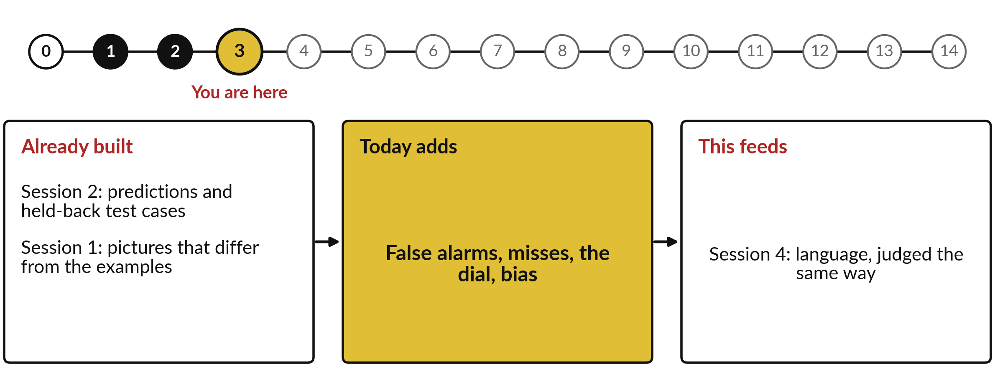
What today builds on, and where it leads
Each session is built on the ones before it.
Notes:
The dots along the top are the fifteen sessions, from the map at Session 0 to your plan at Session 14; the gold one is today.
Today uses predictions and held-back test cases from Session 2 and pictures that differ from the examples from Session 1.
It adds false alarms, misses, the dial, bias.
Session 4: language, judged the same way.

Slide 6
Words we use today
Word | What it means
False positive | A false alarm: the system flags a case that was fine.
False negative | A miss: the system lets through a case it should have caught.
Accuracy | The share of all cases a system gets right. It hides both mistakes when the event is rare.
Threshold | The cut-off your policy sets, as in Session 2: above it, flag; below it, let through.
Bias | When a system’s mistakes fall more often on one group of people.
Notes:
Five words for today. We use every one of them before the end of the session.
False positive. A false alarm: the system flags a case that was fine.
False negative. A miss: the system lets through a case it should have caught.
Accuracy. The share of all cases a system gets right. It hides both mistakes when the event is rare.
Threshold. The cut-off your policy sets, as in Session 2: above it, flag; below it, let through.
Bias. When a system’s mistakes fall more often on one group of people.

Slide 7
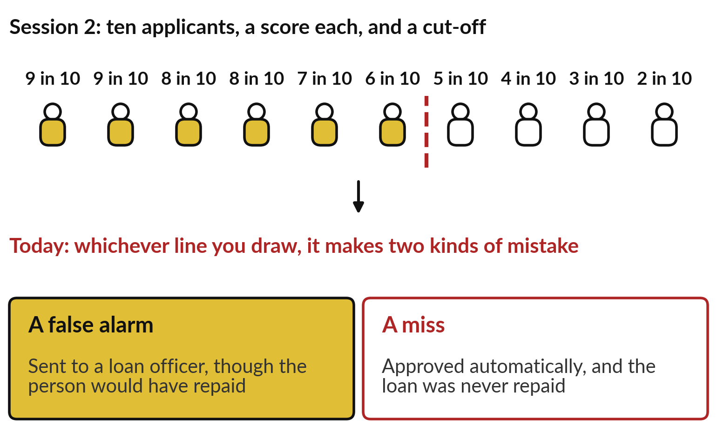
Wherever Session 2’s cut-off falls, some
people land on the wrong side of it
No model avoids both kinds of mistake, because a score is a likelihood.
Today: how many of each mistake, and what each one costs.
Notes:
Those five words grow out of a slide from Session 2. Ten applicants, each with a score, and a line your credit committee drew: above it, approved automatically; below it, a loan officer looks. Whatever line you draw, some people land on the wrong side. Some who would have repaid get stopped for a check, a false alarm.
Some who will not repay sail through, a miss. No model avoids both, because a score is a likelihood. The useful question about any AI system is how many of each mistake it makes, and what each one costs. Kenya’s health insurer has just learned this in public.

Slide 8
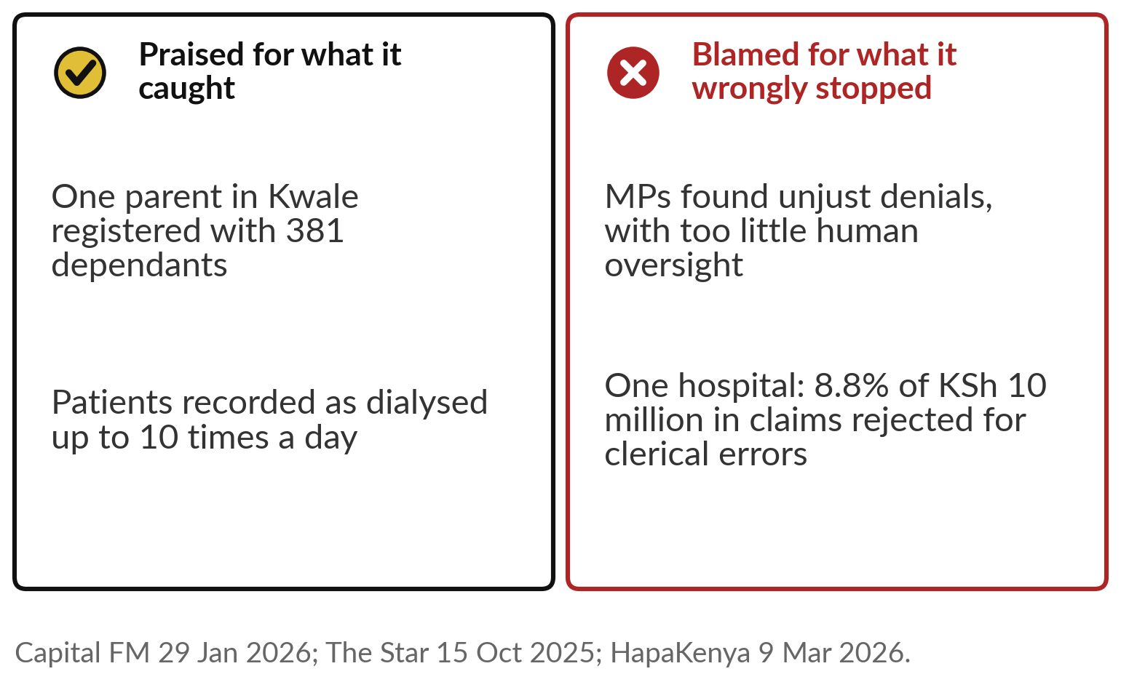
Kenya’s health insurer caught a parent with 381
dependants, and its AI rejected honest claims too
The same engine is praised and blamed, because each side counts a different mistake.
Our question today: how do I judge a vendor who says “95% accurate”?
Notes:
Kenya’s Social Health Authority runs an AI engine that looks for unusual patterns in hospital claims. In January 2026 the health minister told the Senate it had flagged one parent in Kwale registered with 381 dependants, and patients recorded as dialysed up to ten times a day. Those are the minister’s own examples.
In October 2025 a parliamentary committee found that heavy reliance on AI claim processing, with too little human oversight, led to unjust denials. And one hospital reported that 8.8 per cent of its claims, by value, were rejected for clerical errors with no way to resubmit. Same engine, praised and blamed, by people counting different mistakes.

Slide 9
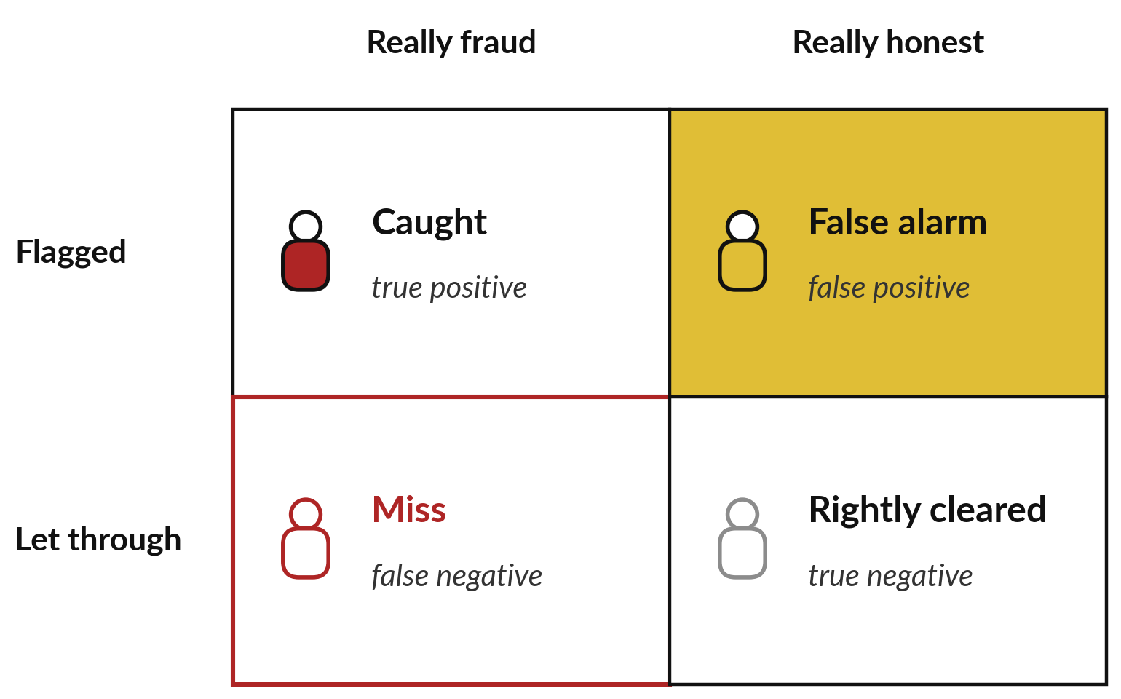
A system can be wrong in two
ways, a false alarm or a miss
A smoke alarm can ring over toast, or stay silent in a fire.
False alarm: the industry says false positive.
Miss: the industry says false negative.
Notes:
The smoke alarm in your kitchen can be wrong in two ways. It rings when you burn the toast: a false alarm. Or it stays silent during a real fire: a miss. Every flagging system works the same way. Take a fraud check. Down the side, what it did: flagged or let through.
Across the top, the truth: really fraud or really honest. Two boxes are right: frauds caught and honest customers cleared. Two are wrong. A false alarm, which the industry calls a false positive, stops an honest customer. A miss, a false negative, lets a fraud through. They cost different things and land on different people.

Slide 10
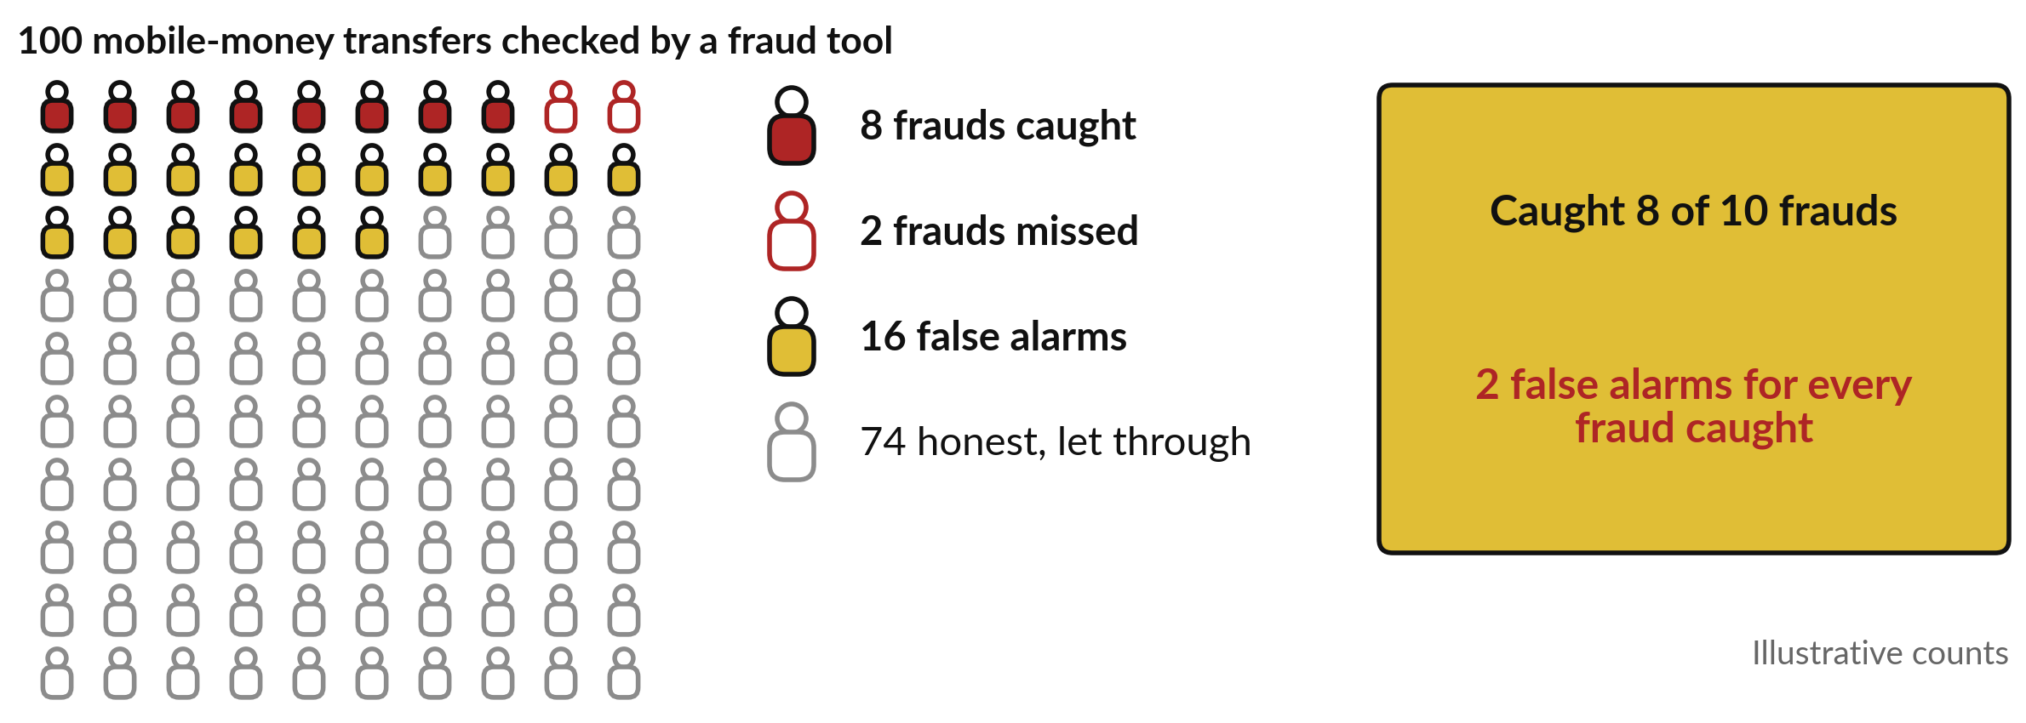
Of 100 transfers with 10 frauds, the tool
catches 8, misses 2 and raises 16 false alarms
Invented counts. A vendor would call this tool 82% accurate.
Notes:
Put numbers on it. These are 100 mobile-money transfers checked by a fraud tool, with invented but realistic counts. Ten are really fraud. The tool catches eight, the red figures, and misses two, the red outlines. It also flags sixteen honest transfers, the gold figures, so sixteen customers have a payment held for no reason.
The other seventy-four pass through rightly. Read it the way a leader should. It caught eight of ten frauds, which sounds good. And it raised two false alarms for every fraud it caught, which is the workload your team and your customers will feel. Both facts are true at once, and a vendor would sum them up as eighty-two per cent accurate.

Slide 11
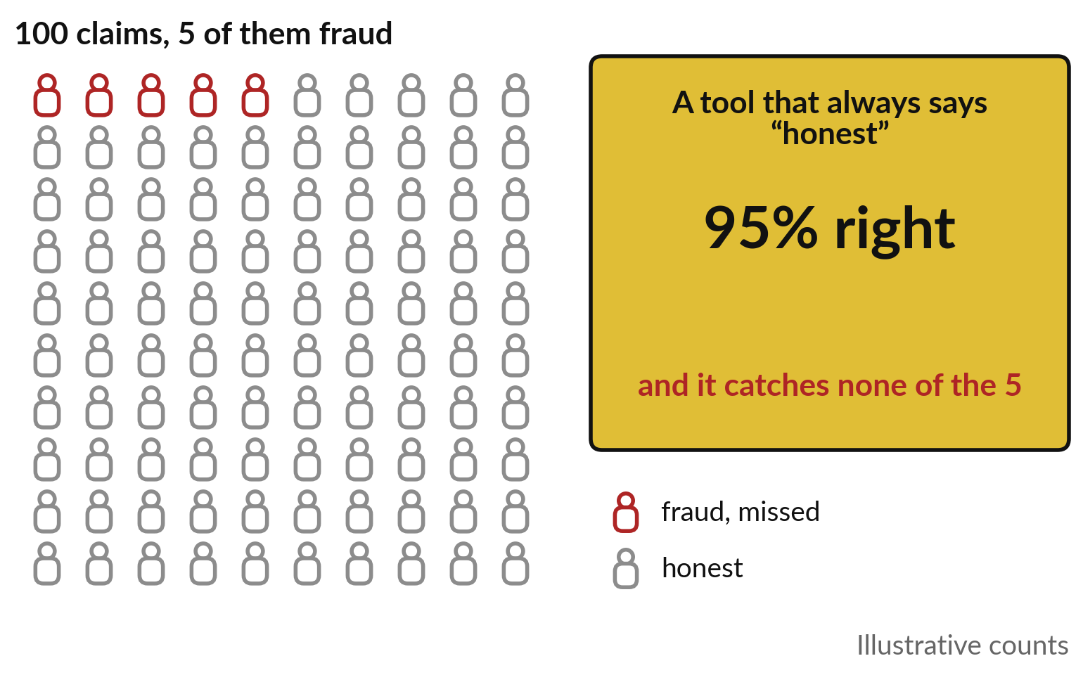
When 5 in 100 claims are fraud, a tool
that always says “honest” is 95% accurate
When the thing you look for is rare, accuracy flatters.
A tool that never flags anything still looks good.
Ask how rare the event is before you hear the score.
Notes:
Eighty-two per cent, because 82 of the 100 transfers were handled rightly. That word misleads. Take 100 claims where five are fraud, which is realistic: fraud, default and machine failure are all rare. A tool that does nothing, and calls every claim honest, is right on 95 of them.
Ninety-five per cent accurate, and it catches none of the five frauds you bought it for. Accuracy counts every case, and when most cases are fine, a lazy tool scores high. So when a vendor says ninety-five per cent, first ask how rare the thing is. If it is rarer than one in twenty, ninety-five per cent may mean nothing. The demonstration shows a recorded case of it.

Slide 12
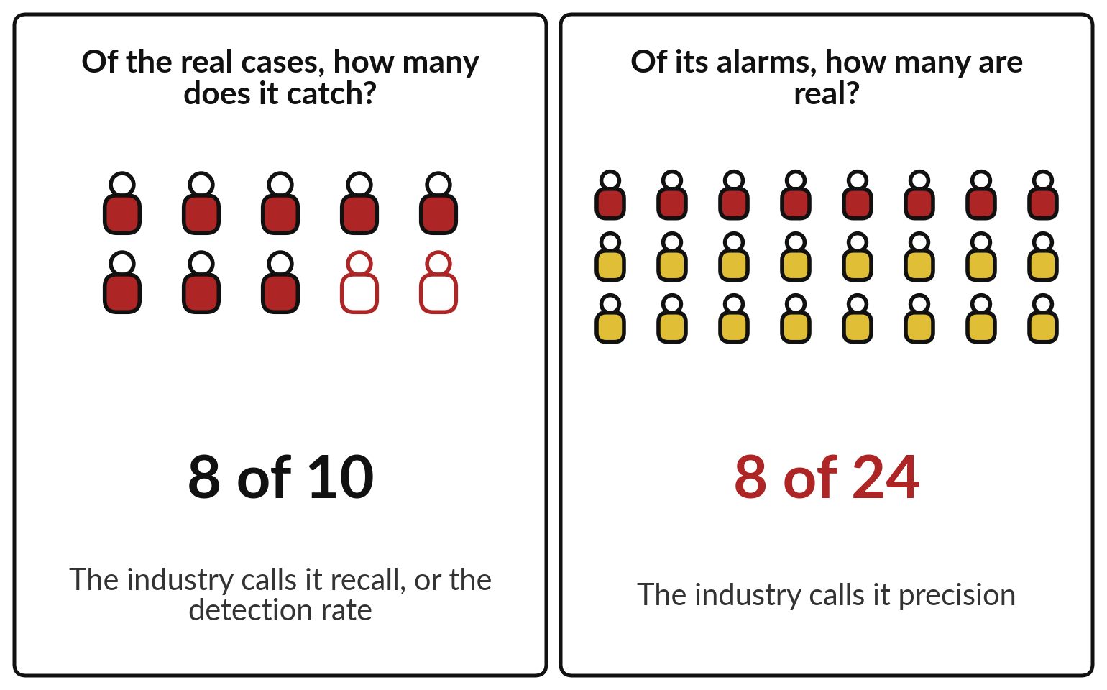
Ask how many real cases it catches,
and how many of its alarms are real
Two counts show what a single accuracy figure hides.
Industry terms: recall for the first, precision for the second.
Ask for both, measured on cases like yours.
Notes:
What should you ask for in place of accuracy?
Two counts, and our 100 transfers give them. First: of the real frauds, how many does it catch?
Eight of ten. The industry calls this recall, or the detection rate; it tells you about misses. Second: of the alarms it raises, how many are real?
Eight of twenty-four, one in three. The industry calls this precision; it tells you how much wasted work and how many upset customers each alarm brings. A tool can score well on one and badly on the other. When a vendor gives you one accuracy figure, ask for these two counts, measured on cases like yours. What moves them is the cut-off from Session 2.

Slide 13
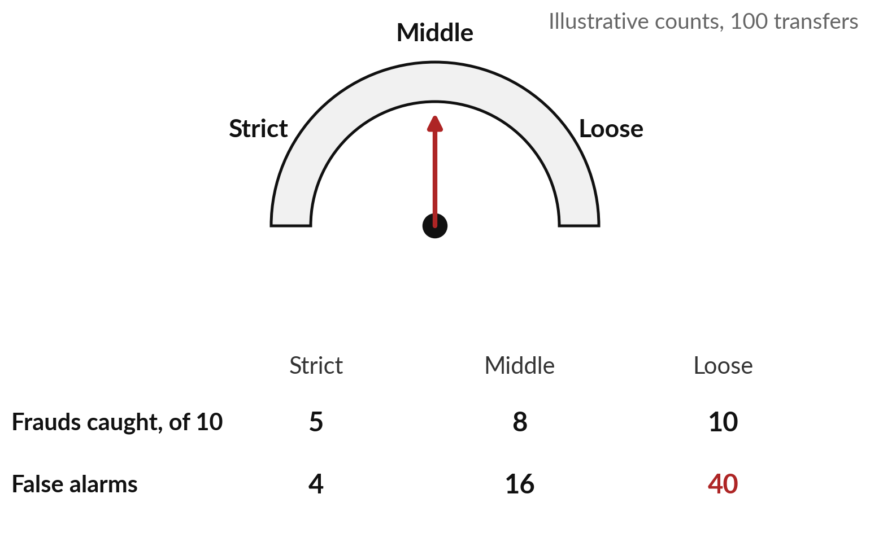
The cut-off is a business dial, and turning it
for more catches brings more false alarms
The model gives scores. Your policy turns the dial.
The model is the same at every setting.
No setting removes both mistakes.
Notes:
The threshold works like a dial. Turn it to strict, and the tool flags only the highest scores: in our illustration it catches five of ten frauds with four false alarms. Middle: eight caught, sixteen false alarms, the slide you saw. Loose: all ten caught, and forty honest customers stopped.
The model is the same in all three; only the dial moved. More catches always cost more false alarms, and no setting removes both mistakes. Who should set it, then?
Someone who knows what each mistake costs the business, usually a manager or a committee, never the vendor by default. That person needs a price for each mistake.

Slide 14
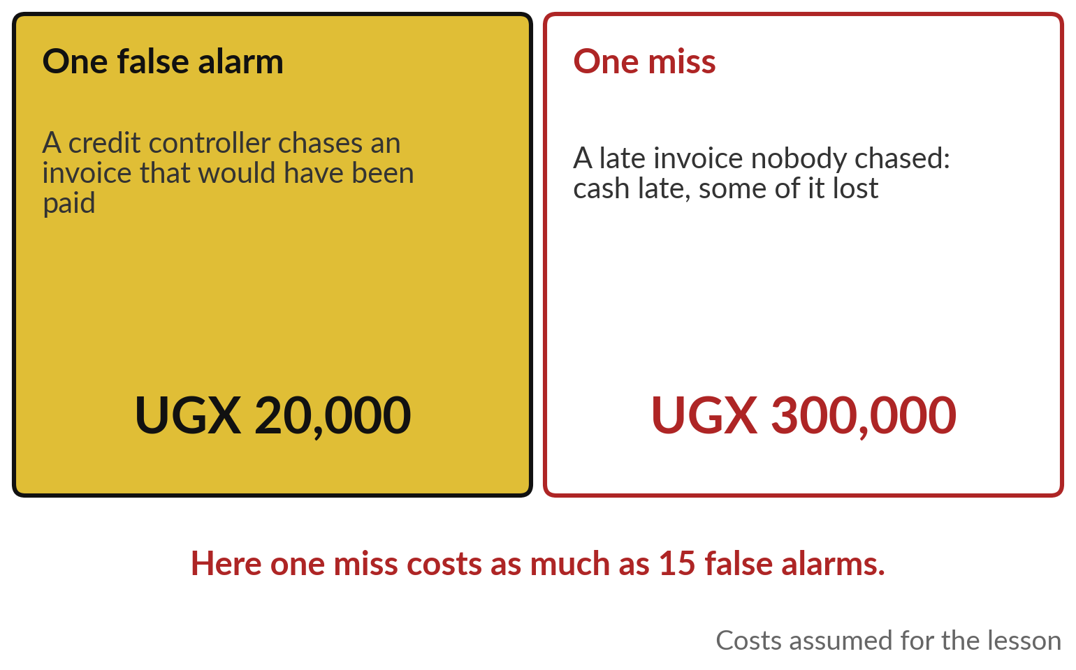
Price each mistake in shillings, and the
right setting becomes a business decision
A false alarm costs a check. A miss costs a loss.
Both prices here are assumptions; yours will differ.
Choose the setting with the lowest total.
Notes:
To set the dial, put a price on each mistake. Take a distributor chasing late invoices. A false alarm means a credit controller calls a customer who would have paid on time: some staff time, and a little goodwill. Say twenty thousand shillings. A miss means a late invoice nobody chased: cash arrives late, and some of it never arrives.
Say three hundred thousand. Both figures are assumptions for the lesson. Here, one miss costs as much as fifteen false alarms, so you would accept quite a few alarms to avoid a miss. In a hospital or a court the price of a miss may be far higher. The demonstration does this sum on a recorded model.

Slide 15
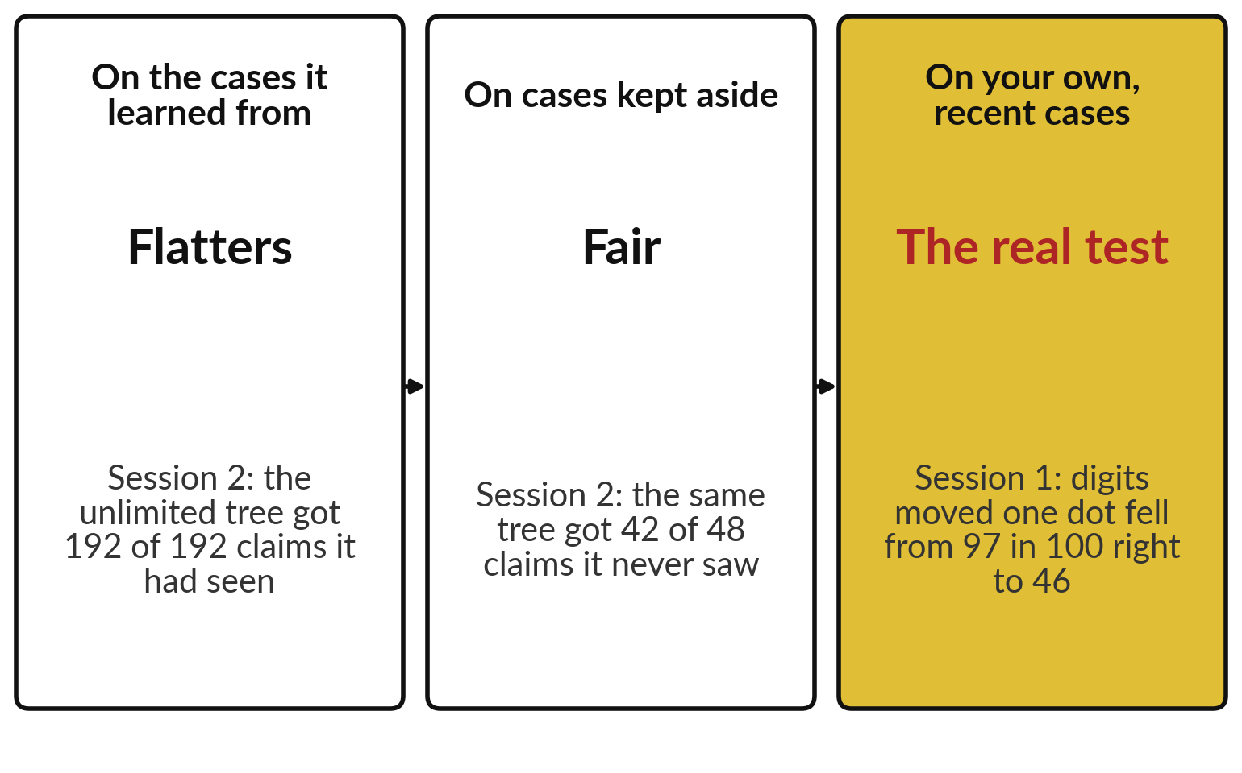
Test on cases the system never saw, and
then on your own, as in Sessions 1 and 2
A score is only as good as the cases it was measured on.
Your own recent cases are the real test.
Ask for a trial on a sample of yours before you sign.
Notes:
Every count we have used must be measured on the right cases, and you have met this twice already. In Session 2, the tree with no limit got 192 of 192 claims right that it had learned from, and only 42 of 48 that it had never seen.
Scores on learned-from cases flatter. Kept-aside cases are fair. And Session 1 showed the harder test: our digit network read 97 in 100 correctly, and only 46 once the same digits moved one dot. A vendor’s score was measured on the vendor’s cases. The real test is your own recent cases, with your customers, your forms and your season.
Ask for a trial on a sample of your own before you sign.

Slide 16
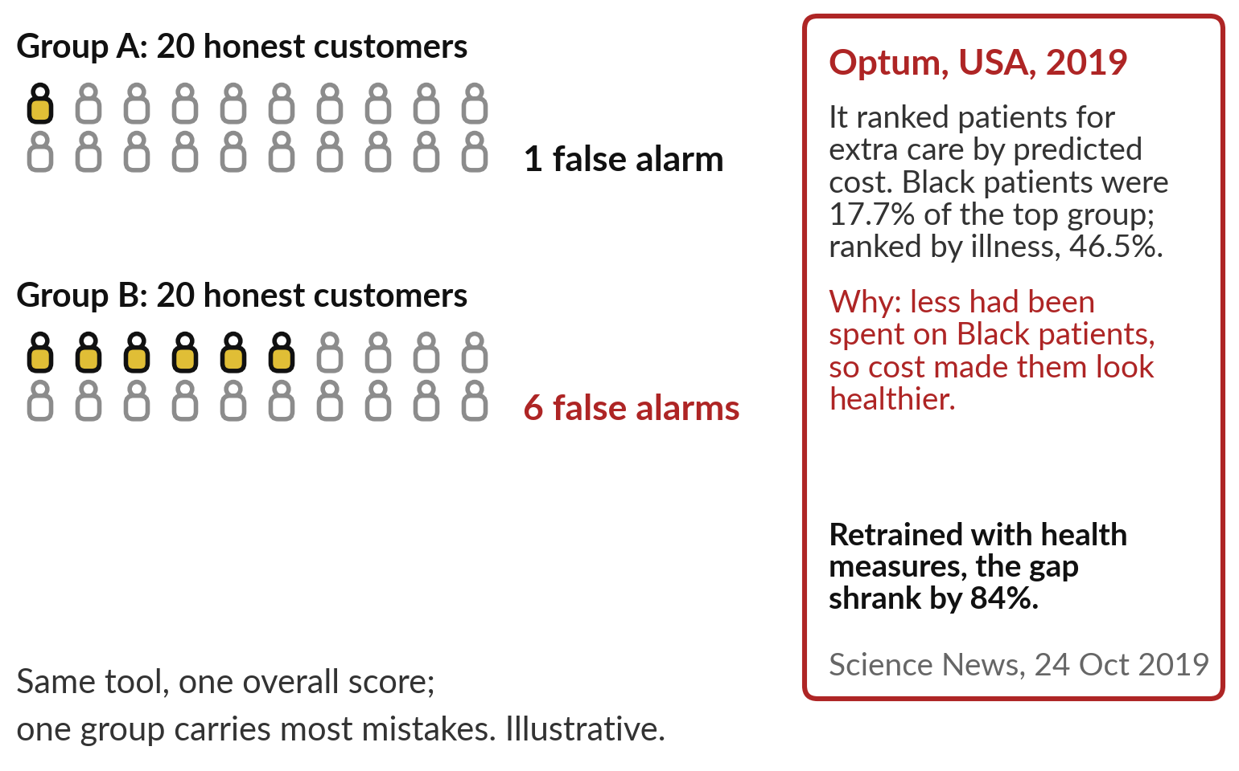
The mistakes can fall more often on one group even
when the overall score looks fine, which is called bias
Count the mistakes for each group as well as in total.
Retrained with health measures, the Optum gap shrank by 84%.
Notes:
A single score can hide who carries the mistakes. On the left, illustrative counts: two groups of twenty honest customers. Group A gets one false alarm, group B six. The overall score looks fine, yet one group is stopped six times as often. The industry calls this bias.
On the right, a real case from the United States. A widely used algorithm ranked patients for extra care by their predicted cost. Because less had been spent on Black patients in the past, they looked healthier than they were: 17.7 per cent of the top group, against 46.5 per cent when ranked by illness.
Optum cooperated with the researchers, and retrained with health measures as well as cost, the gap shrank by 84 per cent, a design flaw that could be fixed. Ask for the counts by group.

Slide 17
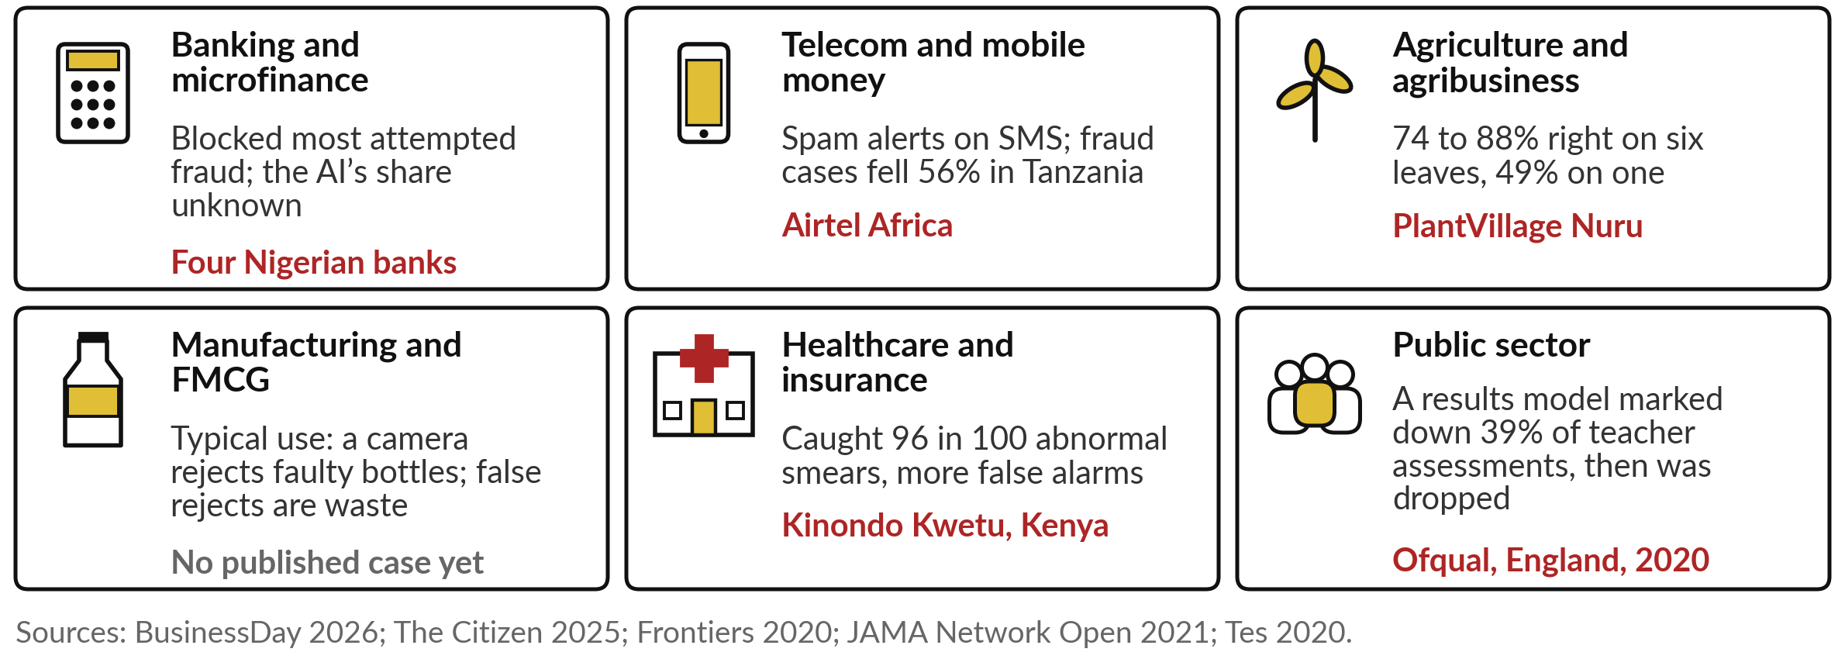
Nigerian banks, Airtel, a Kenyan clinic and England’s
school results all show a score that needed judging
Manufacturing is the gap: no published case of a bottle-rejecting camera’s mistakes yet.
Notes:
Each of the six main industries has met today’s idea. In banking, four Nigerian banks blocked or recovered about 14.5 billion naira of 17.5 billion in attempted fraud in 2025, but the report never says what the AI added. In mobile money, Airtel’s spam alert, which we open next.
In agriculture, PlantVillage Nuru, from Session 0: 74 to 88 per cent right on six leaves and 49 on one, so the method changes the score. In manufacturing, the typical use is a camera rejecting faulty bottles on the line, which makes the same trade between waste and escapes; we have no published case yet.
In health, a Kenyan clinic caught 96 in 100 abnormal smears, with more false alarms. And in England in 2020, a statistical model, not machine learning, that adjusted school results marked down 39 per cent of teacher assessments, and was dropped after protests.

Slide 18
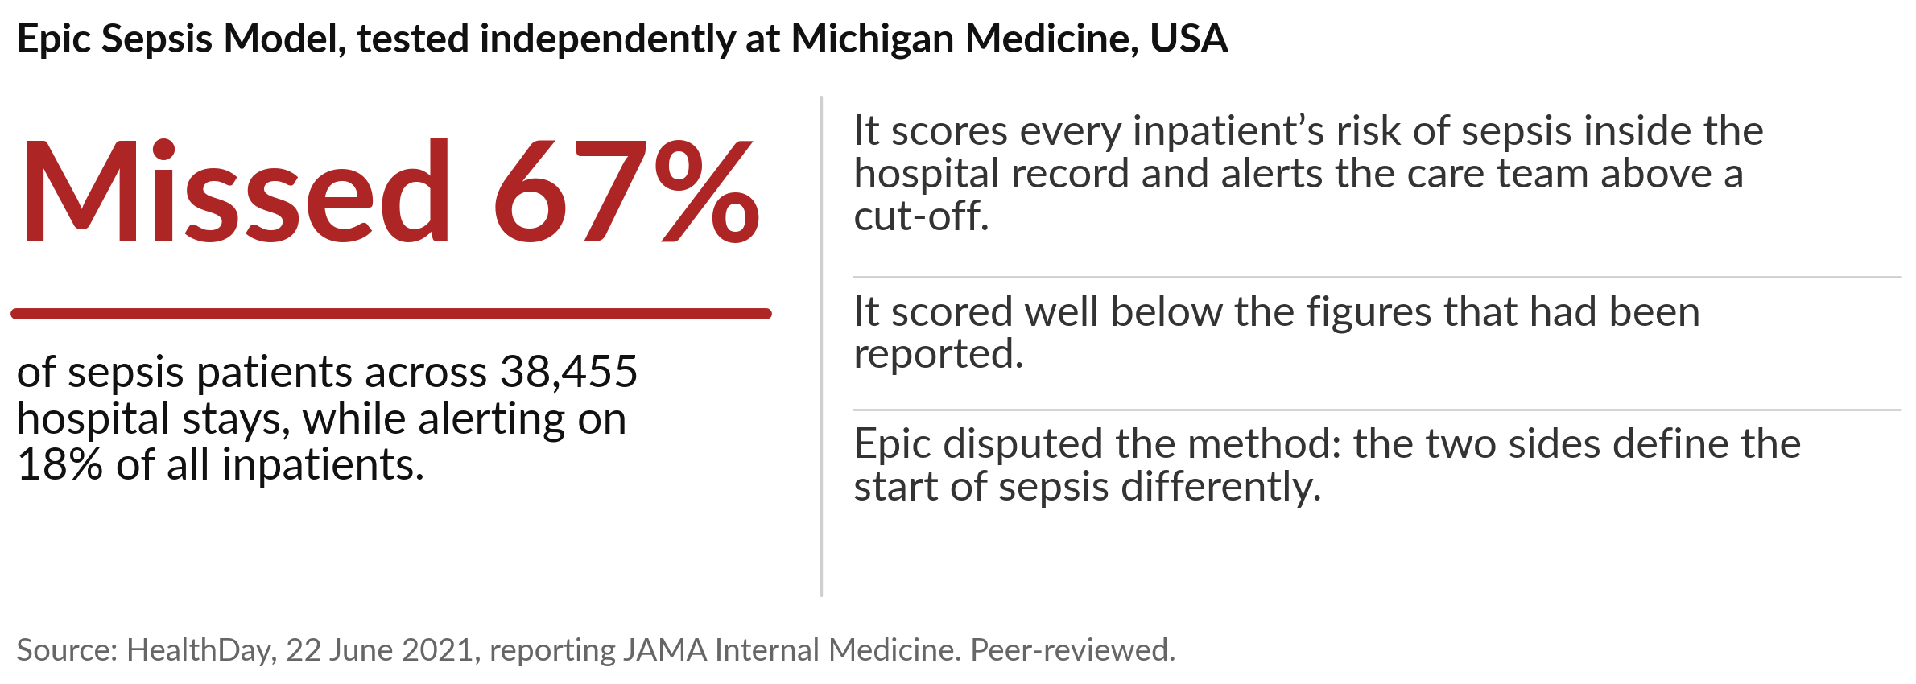
Tested at one US hospital, Epic’s sepsis model missed
2 in 3 sepsis patients and alerted on 1 in 5 of all
Many misses and many false alarms at once. Test any vendor model on your own patients.
Notes:
The first story shows why you test on your own cases. Sepsis kills fast, so hospitals want an early warning. Epic, a large supplier of hospital record systems, sells a model that scores every inpatient’s risk and alerts the care team above a cut-off. Researchers at Michigan Medicine tested it on 38,455 hospital stays.
It missed 67 per cent of the sepsis patients, about two in three, and yet raised alerts on 18 per cent of all inpatients, about one in five, a heavy load of false alarms for nurses and doctors. Its overall score was well below the figures that had been reported.
Epic disputed the method, because the two sides define the start of sepsis differently. Either way, test on your own patients.

Slide 19
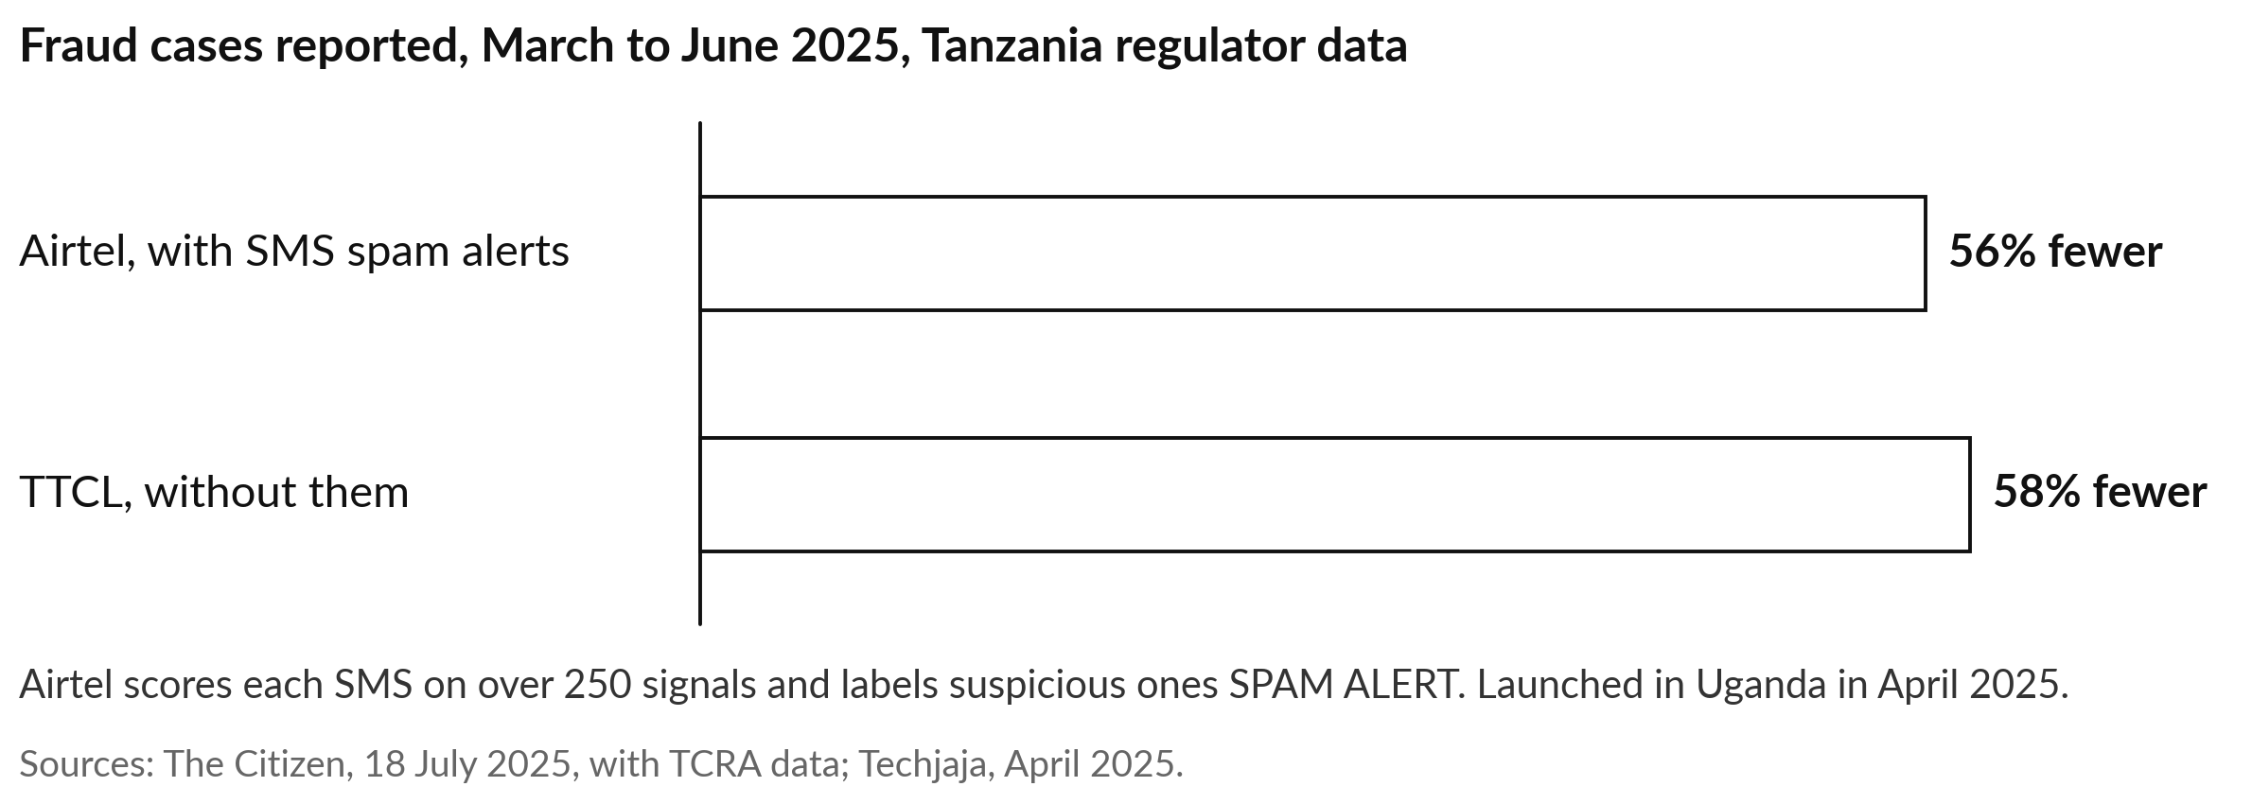
Fraud cases on Airtel Tanzania fell 56% after its
spam alert; on a network without one they fell 58%
A before-and-after figure is no proof. Ask what the AI added against a fair comparison.
Notes:
The second story is about the comparison behind a claim. Scam texts reach most phone users; Uganda’s Communications Commission estimates mobile scams cost Ugandans about twenty-three billion shillings in 2024. Airtel’s network scores each incoming SMS on more than 250 signals and labels suspicious ones SPAM ALERT, and Airtel says it does not read or store the content.
It launched in Uganda in April 2025. In Tanzania, regulator data showed fraud cases on Airtel’s network fell from 5,876 in March to under 2,600 in June 2025, about 56 per cent. Over the same months TTCL’s cases fell 58 per cent without this product. The two bars are almost the same length, so the before-and-after figure proves little.

Slide 20
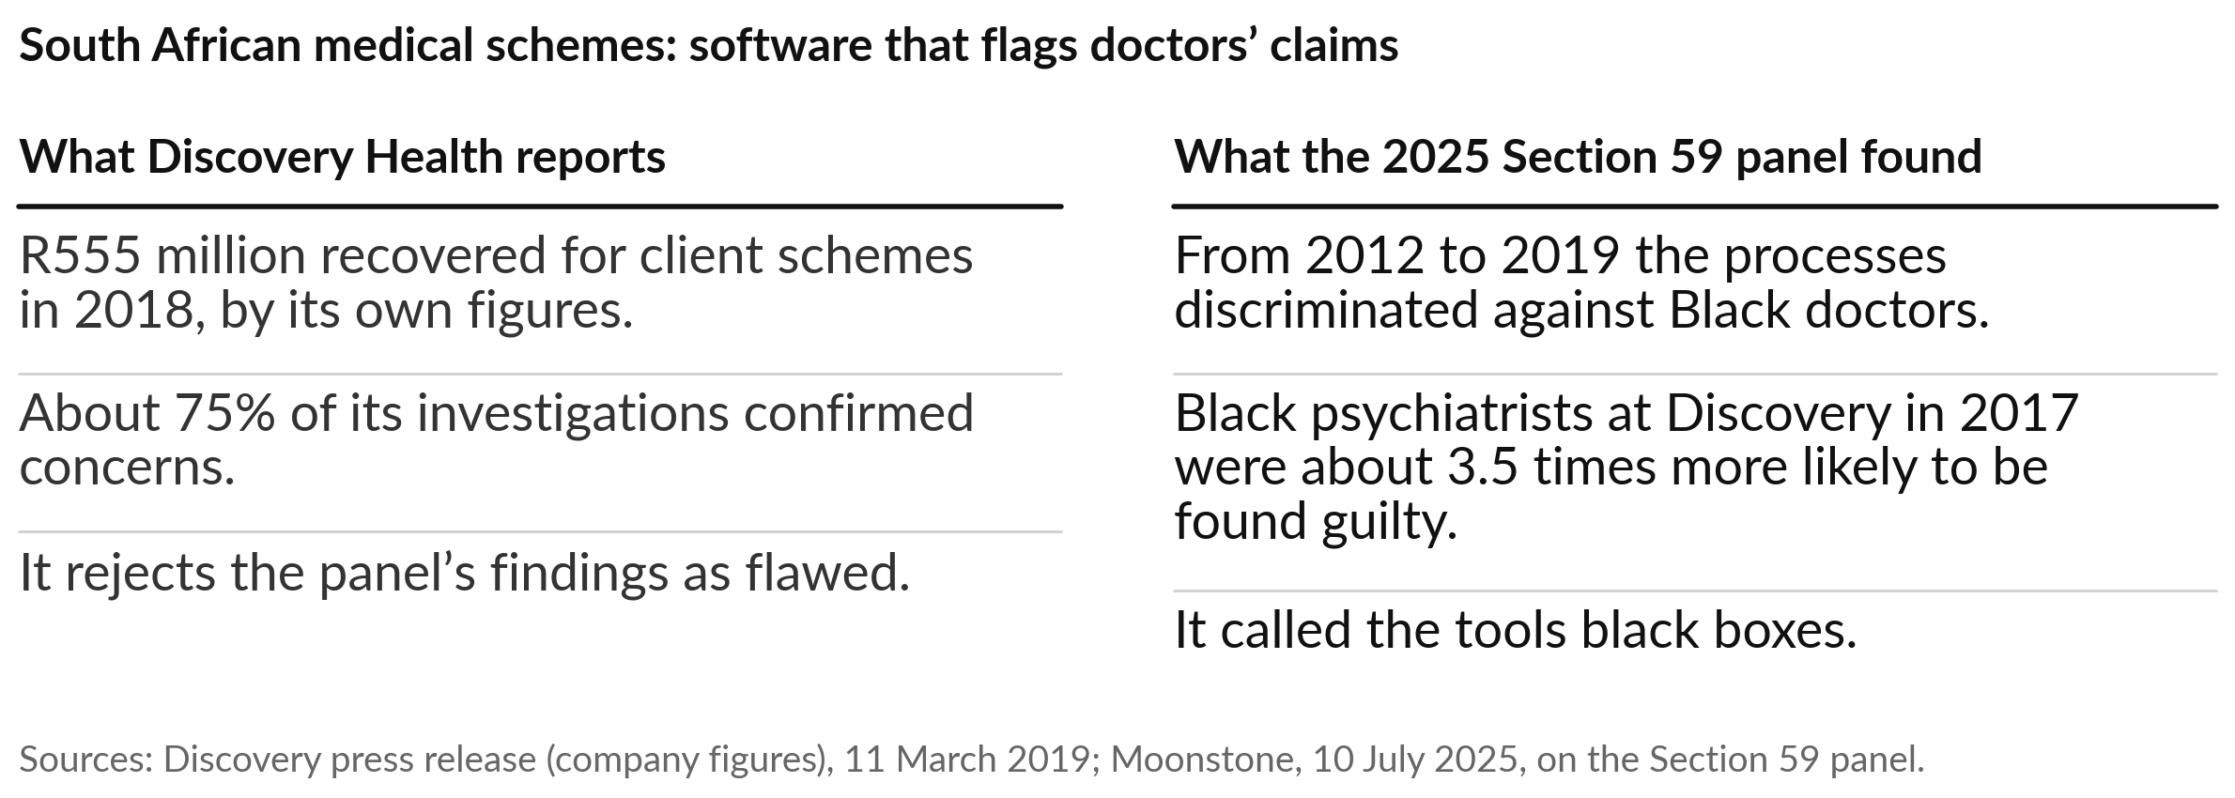
South African fraud algorithms recovered millions,
and a panel found they fell harder on Black doctors
A tool can pay for itself and still spread its mistakes unevenly. Count by group.
Notes:
The third story is about bias, on our own continent. South African medical schemes use software to flag doctors whose billing looks irregular; investigators then pursue them and claw money back. Discovery Health says it recovered 555 million rand for client schemes in 2018, and that about three in four investigations confirmed concerns.
In 2025 an investigation panel found that between 2012 and 2019 these processes discriminated against Black doctors. In one example, Black psychiatrists at Discovery in 2017 were about three and a half times more likely to be found guilty. The panel called the tools black boxes. Discovery and the funders’ board reject the findings as flawed, so hold both sides.
A tool can pay for itself and still spread its mistakes unevenly.

Slide 21
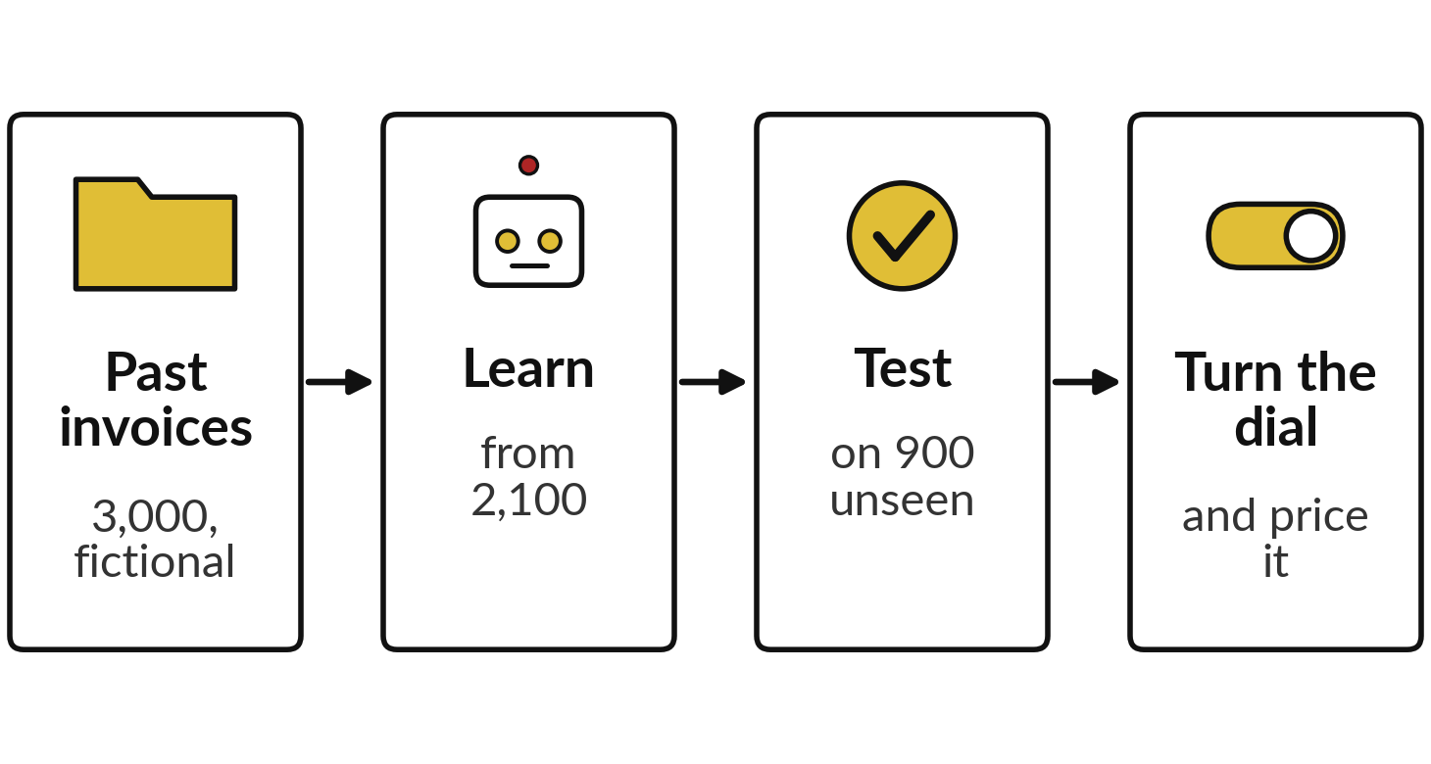
A recorded model flags invoices likely to
be paid late, tested on 900 it never saw
I will show
Watch for
What doing nothing scores
How catches and false alarms move together
Which setting costs least, and why it changes
Notes:
Now all of this on one model, on a task finance teams know: which invoices will be paid late. I made 3,000 invoices for Nile Valley Foods, our fictional distributor, with a short script; the rule behind them is mine. A model learned from 2,100 and was tested on 900 it never saw, of which 83 were paid late, about 9 in 100.
These are recorded runs with scikit-learn from 6 November 2026, and the seeds are fixed, so a re-run prints the same numbers. Watch what doing nothing scores, how catches and false alarms move together as I turn the dial, and which setting costs least once we price each mistake.

Slide 22
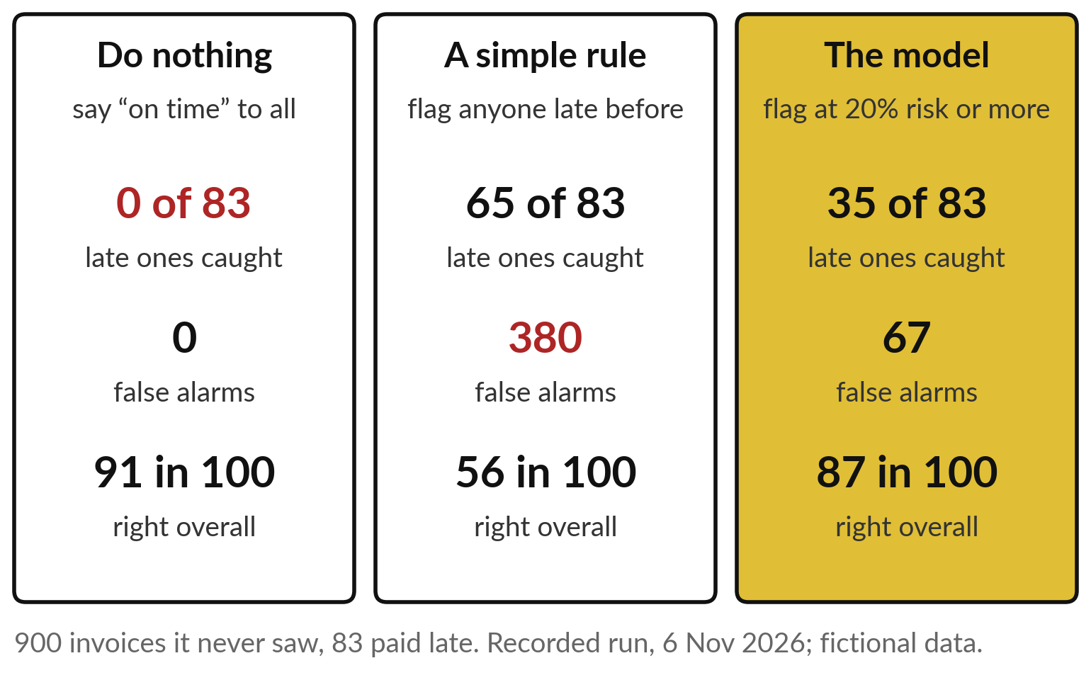
Doing nothing scores 91 in 100 and
catches none of the 83 late invoices
The most accurate option is the useless one.
The simple rule catches the most and swamps the team.
Notes:
The trap from earlier, in recorded numbers. Saying on time to every invoice is right on 817 of the 900, 91 in 100, and catches none of the 83 late ones. A simple rule, flag anyone who paid late before, catches 65 of the 83, but raises 380 false alarms and is right overall on only 56 in 100.
The model, flagging invoices with a risk of 20 per cent or more, catches 35 with 67 false alarms, 87 in 100 overall. So the most accurate option is the useless one, and the rule catches the most while swamping the team. Which is best depends on the dial, and on the price.

Slide 23
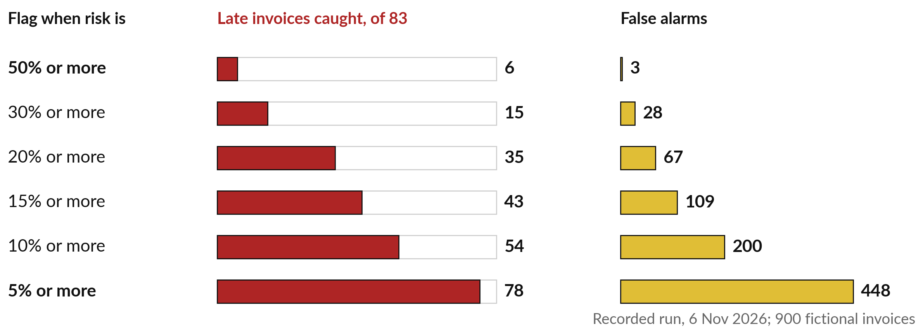
At a 50% cut-off the model catches 6 of 83 late
invoices; at 5% it catches 78, with 448 false alarms
One model at six settings. At 5%, credit control would call 526 customers.
Notes:
This is the same model at six settings of the dial. Each row is a cut-off: flag an invoice when its risk is 50 per cent or more, down to 5 per cent or more. The red bars are late invoices caught, out of 83; the gold bars are false alarms.
At 50 per cent it is cautious: 6 caught and 3 false alarms. At 20 per cent, 35 caught and 67 false alarms. At 5 per cent it catches 78 of the 83, missing only 5, and raises 448 false alarms, so credit control would call 526 customers.
Same model, very different jobs. No row is right in itself; choosing one needs the price of each mistake.

Slide 24
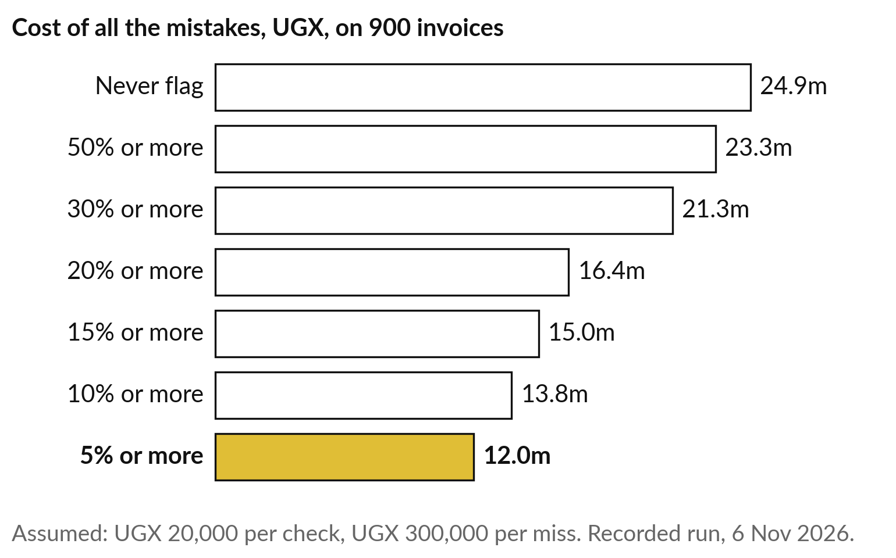
With a miss priced at UGX 300,000,
the loosest setting costs least
Each false alarm counted at UGX 20,000, each miss at UGX 300,000.
Never flag: UGX 24.9 million in misses.
At 5%: UGX 12.0 million, the lowest.
Notes:
Now the price. I counted every false alarm at twenty thousand shillings and every missed late invoice at three hundred thousand, the assumed costs from earlier. Never flagging anything costs 24.9 million shillings in misses on these 900 invoices. At 50 per cent the total is 23.3 million, because it misses so many.
As the dial loosens, the total falls, and at 5 per cent it is lowest, about 12 million, even with 448 false alarms, because each miss costs fifteen times a false alarm. With these prices, the loose setting wins. The model did not choose that; the prices did, and if they change, so does the answer.

Slide 25
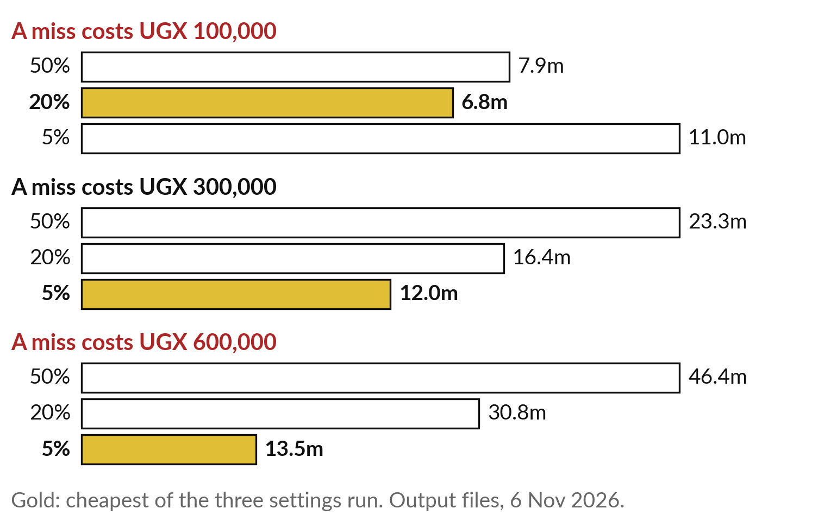
Change the price of a miss,
and the best setting moves
The model never changed. Only the price did.
Miss at UGX 100,000: 20% is cheapest of the three.
Miss at UGX 300,000 or 600,000: 5% is cheapest.
Notes:
I ran the same three settings again with a different price for a miss. If a missed late invoice costs only one hundred thousand shillings, say because most late payers do pay within a month, the cheapest of these three settings becomes 20 per cent, at about 6.8 million.
At three hundred thousand, as before, it is 5 per cent. At six hundred thousand, 5 per cent again, and the gap to the others grows. The model never changed. Only the price changed, and the best setting moved with it. So the dial belongs to a manager who knows the costs, and it should be re-set when the business changes.

Slide 26
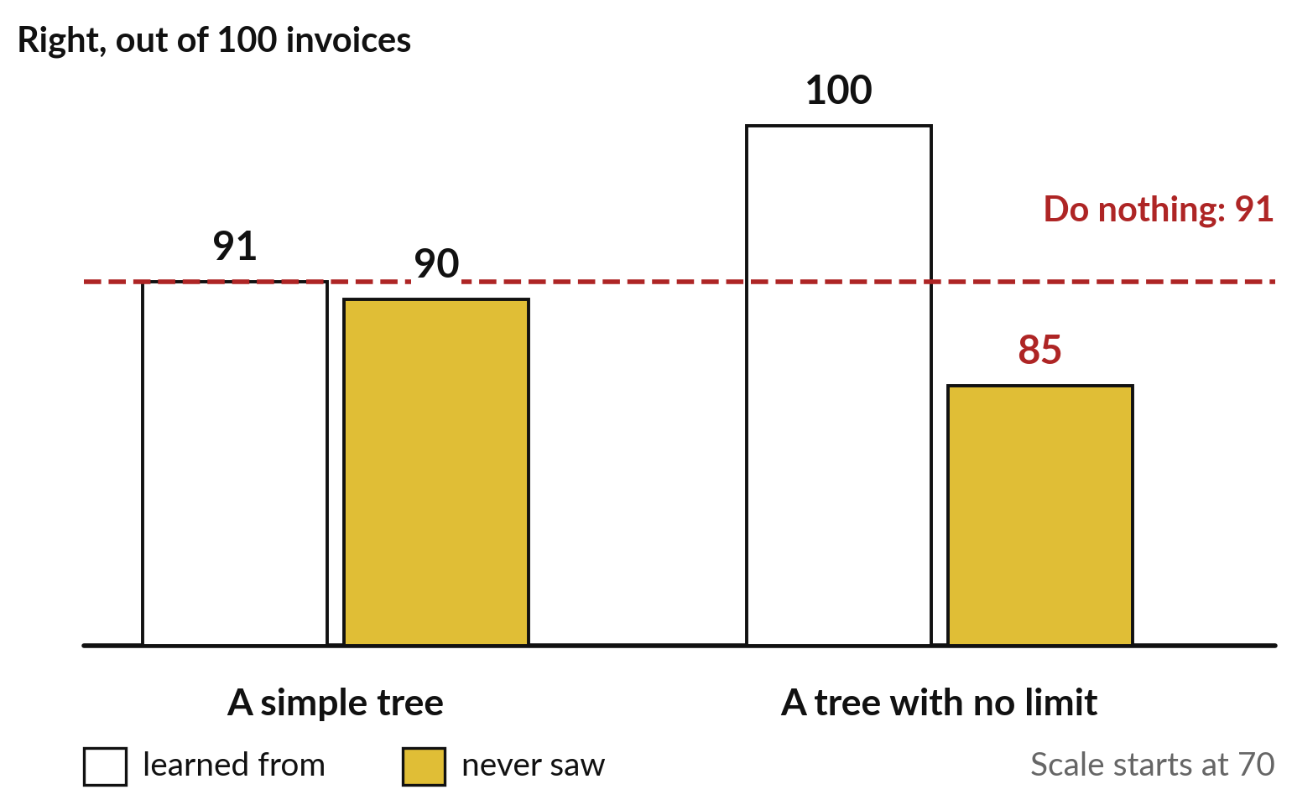
A tree that memorised scored 100 on its own
invoices and 85 on new ones, below doing nothing
Session 2’s overfitting, in the same invoices.
Ask for three numbers: learned-from, unseen and doing nothing.
Notes:
One last recorded lesson, about testing. A simple tree was right on 91 in 100 invoices it learned from and 90 in 100 it never saw. A tree with no limit learned its 2,100 invoices perfectly, 100 in 100, and then got 85 in 100 of the unseen ones, below the 91 for doing nothing at all.
It had learned the slips in its past invoices, the overfitting of Session 2. If a vendor shows you a perfect score, ask which invoices it was measured on, and ask how it compares with doing nothing. Those three numbers, learned-from, unseen and doing nothing, fit on one line of a proposal.

Slide 27
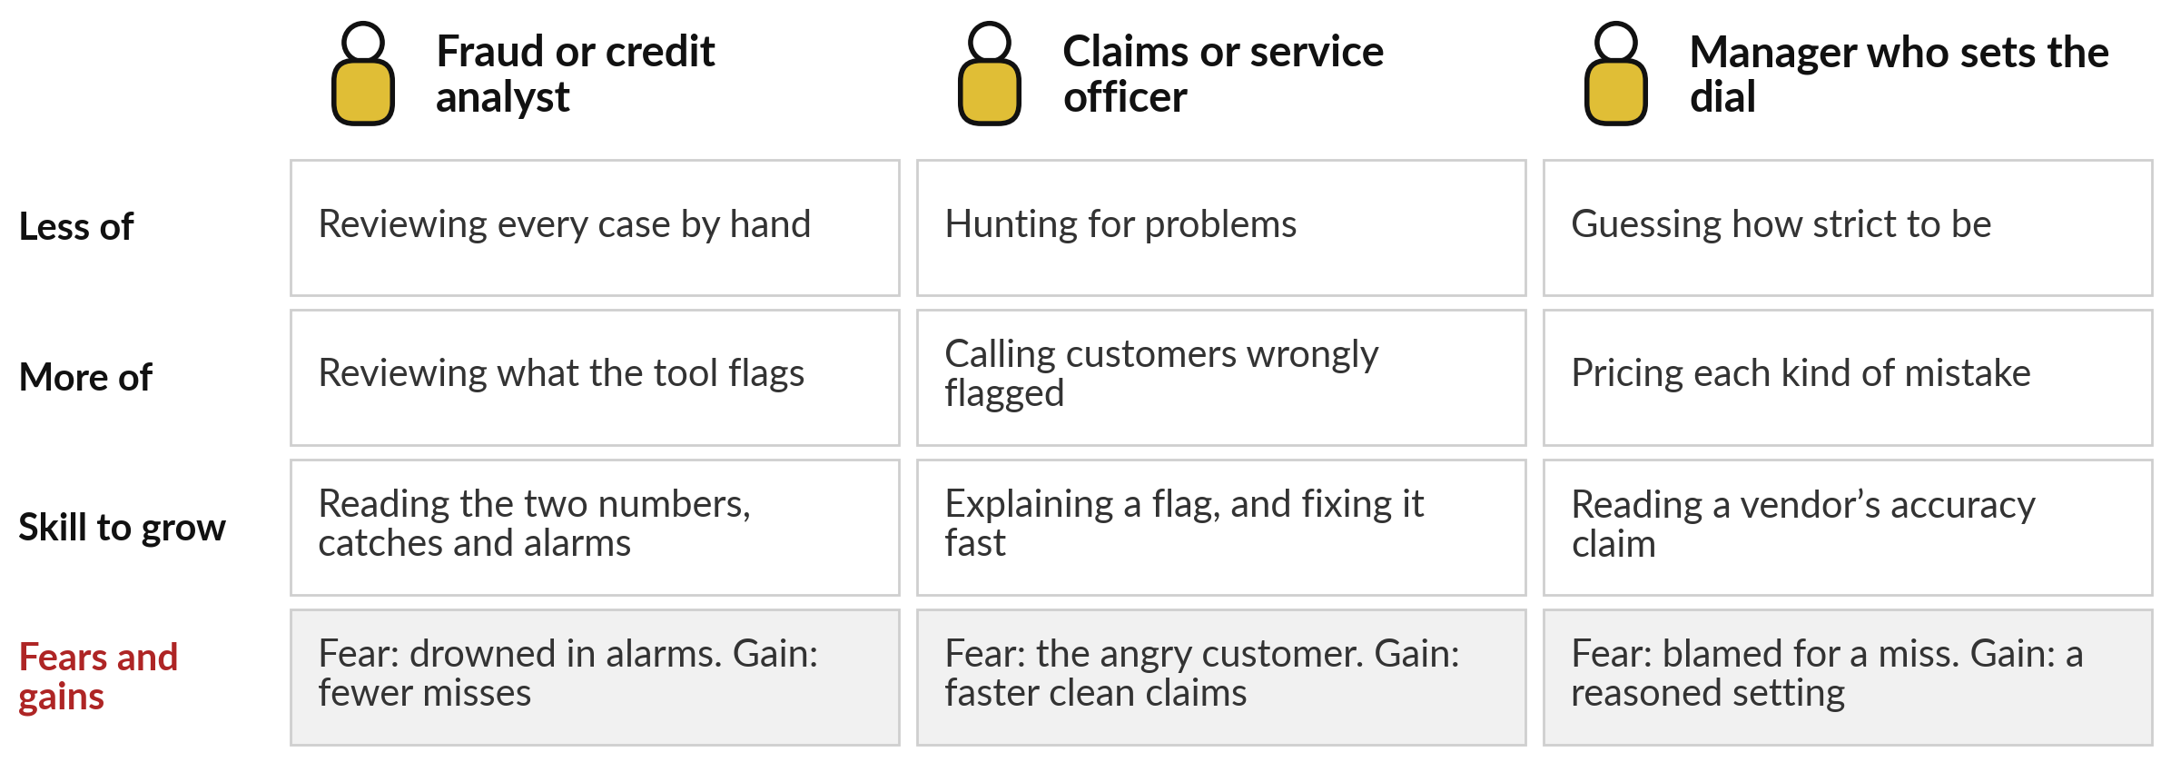
Every alarm lands on someone’s
desk, and someone has to set the dial
448 false alarms means 448 calls. Count the workload before you set the dial.
Notes:
False alarms are work, and every flag lands on someone’s desk. A fraud or credit analyst stops reviewing every case and reviews what the tool flags; the skill to grow is reading the two numbers, catches and real alarms. The fear is being drowned in alarms, as Epic’s nurses were.
A claims or service officer spends more time calling customers who were wrongly flagged, and needs to explain and fix a flag fast. And the manager who sets the dial stops guessing how strict to be and starts pricing mistakes. At the loose setting, 448 false alarms means 448 phone calls.
Who in your organisation would make them?

Slide 28
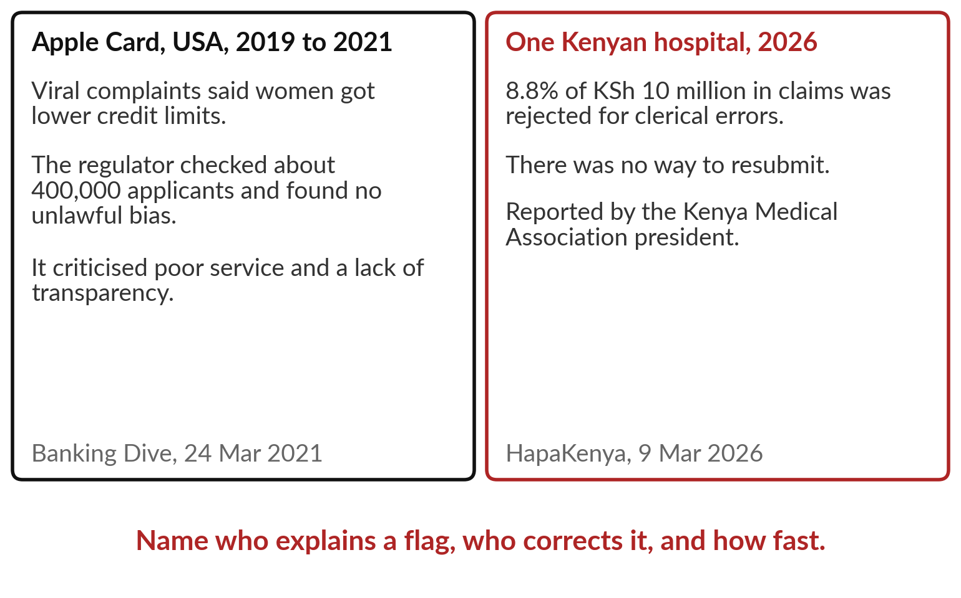
Someone must answer to the
customer who was wrongly flagged
A false alarm is a person with a grievance.
Name who explains a flag, who corrects it, and how fast.
Notes:
Whoever makes those calls, one rule protects your customers and your reputation: someone must answer to the person wrongly flagged. In 2019, viral complaints said Apple Card’s algorithm gave women lower credit limits. New York’s regulator checked about 400,000 applicants and found no unlawful discrimination, but criticised poor customer service and a lack of transparency; the damage was done by the failure to explain.
In Kenya, one hospital reported that 8.8 per cent of its claims, by value, were rejected for clerical errors, with no way to resubmit. Before a tool goes live, name who explains a flag, who can correct it, and how fast.

Slide 29
Six questions to put to any
vendor who says “95% accurate”
Ask | Why it matters
How rare is the thing it looks for, in cases like ours? | When it is rare, accuracy flatters
Of the real cases, how many does it catch? | Each miss costs a loss
Of its alarms, how many are real? | Each false alarm costs work and goodwill
Measured on which cases: learned-from, kept aside, or ours? | Only unseen and own cases are fair
How does it compare with doing nothing, and with our current rule? | A tool must beat the simple option
Are the mistakes spread evenly across groups? | Bias hides inside a good total
Notes:
Everything today fits on one sheet of six questions, and it goes home with you. Ask how rare the thing is in cases like yours, because when it is rare, accuracy flatters. Ask how many of the real cases it catches, because each miss costs a loss. Ask how many of its alarms are real, because each false alarm costs work and goodwill.
Ask which cases the numbers were measured on. Ask how it compares with doing nothing and with your current rule; our rule caught more invoices than the model at 20 per cent. And ask whether the mistakes are spread evenly across groups. The same six questions work on your own portfolio.

Slide 30
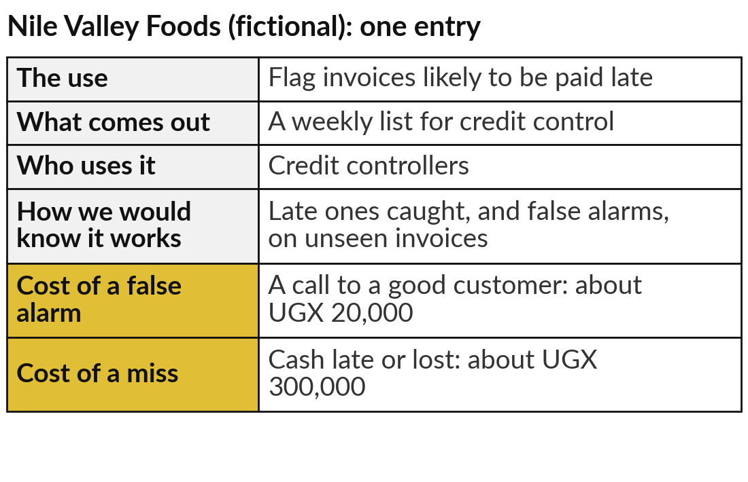
Price the mistakes for each entry
in your AI Opportunity Portfolio
25 minutes
Hands-on: your portfolio
For each entry, write what a false alarm and a miss would cost you.
Name the false alarm and the miss for each entry.
Put a rough shilling figure on each.
Say which matters more, and so which way to turn the dial.
Write how you would test it on your own cases.
You keep: A cost-of-a-mistake line for every portfolio entry.
Notes:
For twenty-five minutes you work on your own portfolio, and I walk round. Take each entry you wrote in Sessions 0 to 2. For each, name the false alarm: what happens when the tool flags something that was fine, and who pays for it. Then name the miss: what happens when it lets through something it should have caught.
Put a rough shilling figure on each; a range is fine, such as twenty to fifty thousand. Then say which costs more, and so which way you would turn the dial. Finish with how you would test it on your own recent cases. The example on the right is for Nile Valley Foods, our fictional distributor.

Slide 31



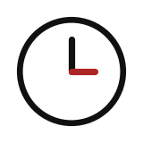
For your first AI use, which
way would you turn the dial?
Look at your most promising entry. Which way would you turn the dial, and why?
Catch more
Fewer alarms
Balanced
Not yet
Misses are costly: fraud, safety, a lost loan
Checks are costly, or flags upset good customers
Both cost about the same; start in the middle
We cannot price the mistakes or test on our own cases
Write your decision and the reason in your workbook.
Notes:
With your mistakes priced, one decision for your most promising entry. Catch more, if a miss is costly: fraud, a safety failure, a loan that is never repaid. Fewer alarms, if each check is expensive or a wrongly flagged customer walks away. Balanced, if both cost about the same, and you start in the middle and adjust.
Or not yet, if you cannot yet price the mistakes or test on your own cases; that is a sound answer, and your first step is to find those figures. Kenya’s insurer is the reminder: the same engine was praised and blamed. Write your setting and the cost that decided it; I will ask a few of you to read them out.

Slide 32
Set the dial where your mistakes cost least,
and judge the tool on cases it never saw
Doing nothing scored 91 in 100 on our invoices and caught no late payer.
Ask how many real cases it catches and how many alarms are real.
Test on your own cases, and count by group.
Notes:
Take this chart home in your head. The model was the same at every setting; the prices of a false alarm and a miss decided which setting was cheapest, and when a miss cost three hundred thousand shillings, the loosest one won. Around it sit the rest of today.
A system is wrong in two ways, false alarms and misses. When the thing you look for is rare, ninety-five per cent accurate can mean nothing; doing nothing scored 91 in 100 on our invoices. Ask how many real cases it catches and how many of its alarms are real, on your own cases and for each group.

Slide 33
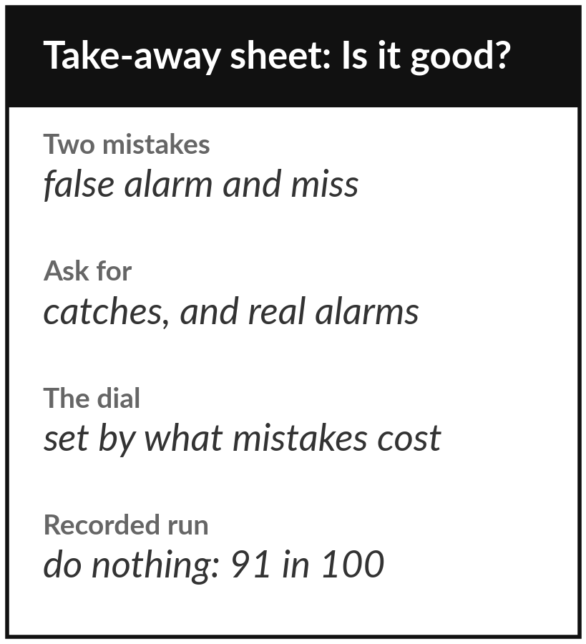
Keep the question sheet, and the cost
of a mistake for each portfolio entry
What you keep from today
The vendor question sheet on accuracy, and a cost-of-a-mistake line for each entry in your AI Opportunity Portfolio.
Our question today
How do I judge a vendor who says “95% accurate”, and what will its mistakes cost us?
Next session
Session 4: AI that understands language: sort, search, translate and summarise.
Notes:
Keep the question sheet. It holds the two kinds of mistake, the two questions to ask in place of accuracy, the dial, the price of each mistake, and today’s recorded numbers: doing nothing scored 91 in 100 and caught no late invoice, and the cheapest setting moved when the price of a miss moved.
Every later tool in this course is judged this way. In Session 4 we turn to language: sorting, searching, translating and summarising, and we judge it with the same two questions.
We began with this question: How do I judge a vendor who says “95% accurate”, and what will its mistakes cost us? Before you go, say in one sentence what you can now say about it.

